Slide 1




IEEE International Conference on
Trends in Quantum Computing and Emerging Business Technologies (TQCEBT – 2022)
13-14-15, October’2022
Technical Session #…… Paper ID #5233
Dark Web Image Classification using Quantum Convolution Neural Network
www.ieeelavasa.christuniversity.in
Presenting Author: Soham Satish Bhoir. Affiliations: K. J. Somaiya College of Engineering. soham.bhoir@somaiya.edu

Slide 2
Introduction
Related Works
Problem Definition
Proposed Methodology
Results & Discussions
Conclusion
Future Scope
References
Paper Outline

Slide 3
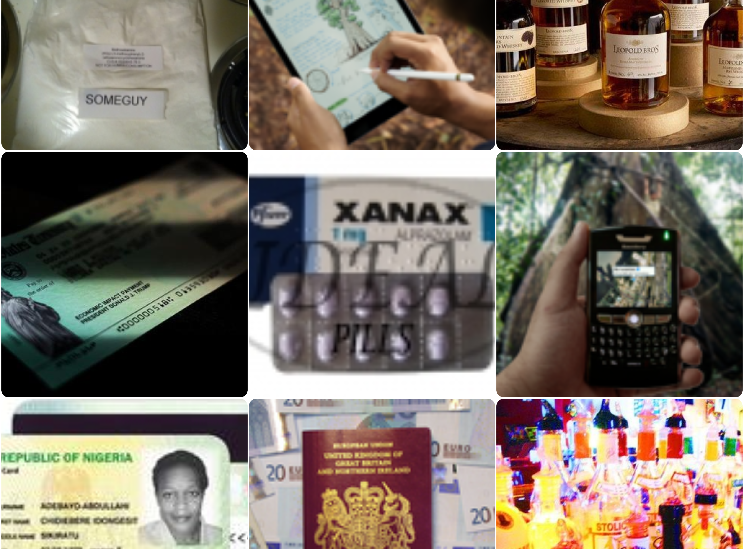
Introduction
Classification and analysis of images collected from the dark web marketplaces will assist in analyzing information shared on these markets.
Also, the open source dark web data is sparse, making it difficult for researchers to train the machine learning model to classify images from different categories.
However, the volume of crawled data is high; thus, performing image classification with classical machine learning or deep learning with traditional computing facilities will be challenging.

Slide 4
RELATED WORK
Researchers attempted image analysis with Compass Radius Estimation for Image Classification (CREIC) on the dark web data.
The work is one of the few attempts to categorize dark web images into five categories.
In other work approaches of perceptual hashing are discussed for dark web image classification.
However, the proposed work aims to employ the advantage of quantum computing to classify dark web image data into four categories.
Many researchers have thoroughly examined the advantages of quantum computing in cybersecurity.

Slide 5
PROBLEM DEFINITION
Researchers have performed image analysis various classical machine/deep learning models.
Classical models required more resources and computing power for a mediocre size of dataset. Thus taking huge amount of time to classify and analyse the data.
Quantum Computing has been a huge boom and its becoming a revolution in terms of machine learning or deep learning.
We need to investigate how quantum computing may reduce the need for a domain specific security. It provided that quantum computing-based representations of standard AES and modified AES algorithms to underline that quantum computing will be a viable solution to improve cybersecurity.

Slide 6



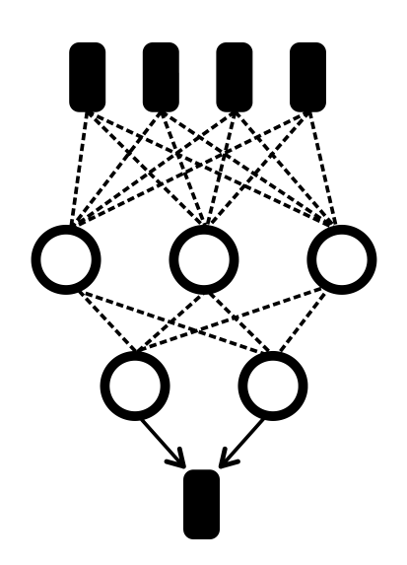
PROPOSED
METHODOLOGY
The proposed work collected image data with a customized dark web crawler. The crawler was run into the instance to collect the data. The collected images are trained into three categories alcohol, devices, and cards.
Because of the limitation of usable images from crawled data, the authors used images of drugs from darknet market archives.
The Images are classified by implementing Quantum Variational Circuit and Quantum Convolutional Neural Network

Slide 7
FLOW OF MODEL
Movement in Network
Moving Image through Neural network using forward and backward pass algorithms and computing the gradient during the backward pass
Neural Network
A Quantum Neural Network with two fully connected layers in the end. (kernel size = 5)
Calculation of State
Computing probabilities for each state and getting the state expectation.
Quantum Circuit
1-Qubit Model with trainable parameter θ Ry rotation by angle θ to train the output of the circuit

Slide 8
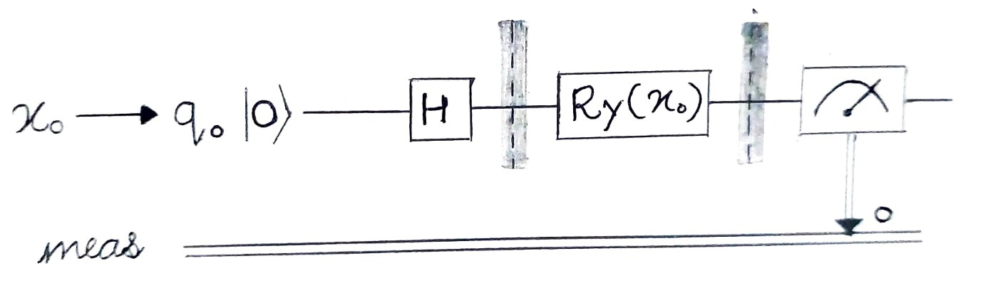
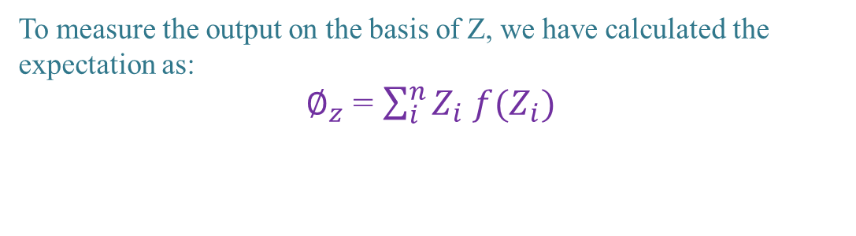
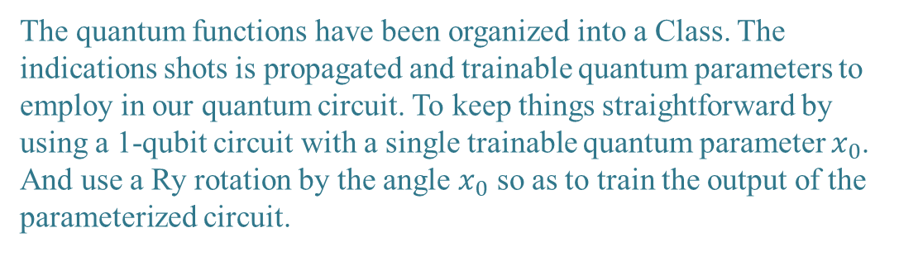
QUANTUM
CIRCUIT
The quantum functions have been organized into a Class. The indications shots is propagated and trainable quantum parameters to employ in our quantum circuit. To keep things straightforward by using a 1-qubit circuit with a single trainable quantum parameter $x_{0}$.
And use a Ry rotation by the angle $x_{0}$ so as to train the output of the parameterized circuit.
To measure the output on the basis of Z, we have calculated the expectation as:
$∅_{z}$ = $\sum_{i}^{n}{Z_{i}}$ $f(Z_{i})$
1-Qubit Quantum Circuit

Slide 9

THE
NEURAL NETWORK
Parameterized quantum circuit
1-qubit
circuit
We have use a parameterized quantum circuit to construct a hidden layer for the neural network to produce a quantum-classical neural network. The term "parameterized quantum circuit" refers to a quantum circuit in which each gate's rotation angle is determined by the elements of a classical input vector. The parameterized circuit will be fed with the outputs from the previous layer of the neural network. The quantum circuit's measurement data may then be gathered and utilized as inputs for the layers below.
Algorithms/type of network used are:
Feed forward neural network
Forward pass for QCNN
Quantum Backpropagation Algorithm (Backward pass)
Hidden layer
2 Layer Node
Forward pass
I/O prep
Quantum Back
Propagation
$$\frac{∂L}{∂F^{l}}$$

Slide 10
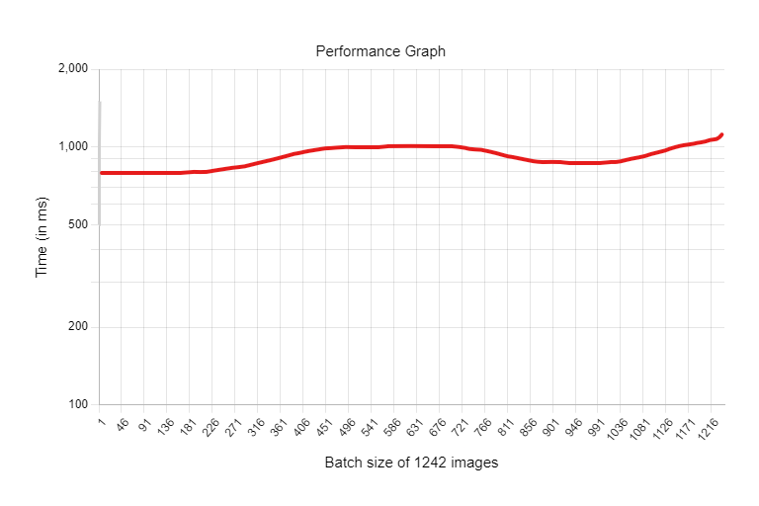
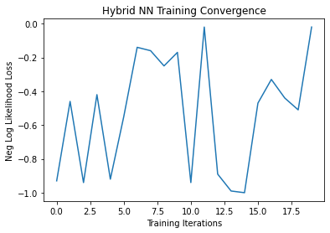
RESULT
Figure 1 shows the performance graph of the proposed model. The data size of 1242 images, and the model performance time is in a few milliseconds. The result shows that quantum-based models significantly reduce training time even with large data sizes.
Machine learning models use epochs to determine which model represents the sample with the lowest amount of error. Before training the neural network, the epoch and batch size must be specified. Figure 2 shows how the negative log-likelihood loss varies over training iterations.

Slide 11

CONCLUSION
The dark web data interests us for a variety of reasons. Typically, the investigation of abusive materials from the dark web.
The proposed work extends the scope of dark web image investigation in two ways: first, collecting a sufficient number of image data sets for work and demonstrating QCNN's effectiveness for dark web image classification. The performance of the proposed model is in milliseconds to classify image data set of 1242 images on the Google colab environment.
Also, the proposed work’s novelty is that the image classification is conducted on dark web marketplace data. The combined custom and open data of different classes are used in the presented work.
Quantum Computing has much upper hand over classical computing in terms of investigation, research etc.

Slide 12
FUTURE SCOPE
Dark web image classification could be further improved by soft standard of labelled image dataset. Currently, more standard dataset is available for image classification. The work can be further extended towards creation of labelled dark web image dataset.
IEEE International Conference on Trends in Quantum Computing and Emerging Business Technologies-2022, CHRIST(Deemed to be University), Lavasa, Pune

Slide 13
REFERENCES
1

Slide 14
“
THANK YOU
For being a kind listener
“

